Slide 1
Project:
Securing the Perimeter
Osman Mohammed:
03/31/2024

Slide 2
Section 1
Designing a Secure Network Architecture

Slide 3
Section 1: Designing the Network
Time to tackle XYZ's perimeter challenges. You've identified that the first thing to do is design a secure network architecture for XYZ. XYZ has provided you a list of business requirements so you can get started on designing a secure layout. Your first task is to incorporate all the requirements securely in a network design.
Use https://app.diagrams.net/ to design a secure network architecture.
Include and label the following requirements in your design:
1) An on-premise network that has 3 workstations in it.
2) A Virtual Network with the following segments:
Public DMZ with two web servers and a load balancer in it.
Private DMZ with two database servers.
Management LAN with one management server in it.
Internal LAN with 5 workstations in it.
Private Secure LAN with 3 database servers.
Additionally include the following:
1) A VPN gateway connecting the on-premise network to your Virtual Network.
2) Show placement of security devices in the architecture, including load balancer(s), firewall(s), IDS/IPS device(s).
3) Show the flow of traffic, and remember to incorporate best security practices with the flow of traffic between the different subnets.

Slide 4
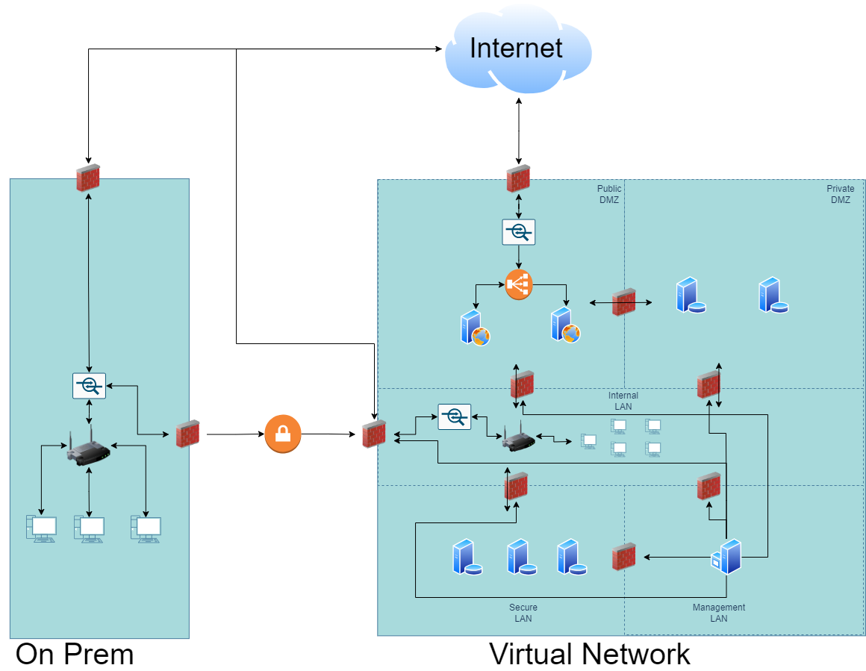
1.1 Designing the Network
Paste your Network Diagram here:
Remove this slide

Slide 5
Section 2
Building a Secure Network Architecture
in Azure

Slide 6
Section 2: Building the Network
After designing the network architecture, you now present your design to XYZ's stakeholders. They're all on board with your design, and have given you the green light to start building the architecture out in Azure.
So your next task is to go the Project Workspace in the classroom, and build out the enterprise network in Azure!
If you are accessing Azure with the Udacity classroom workspace, there will be a Resource Group in Azure called ‘entp-project’ that has already been created for you.
If you are accessing Azure using your own Azure account, first of all you should create a resource group called ‘entp-project’.
This ‘entp-project’ resource group is where you will create all the components that make up this project. When creating VMs in this section, please only use Standard_B1s for your VM size and the Linux Ubuntu 18.04 image.
Insert screenshots of your network on the following pages, showing completion of each of the specified tasks.

Slide 7
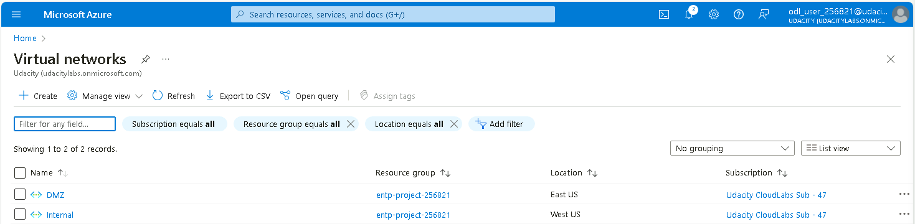
2.1.1 Screenshot
Create two Azure Virtual Networks in the resource group ‘entp-project’. Label one for your DMZ and one as your Internal.

Slide 8
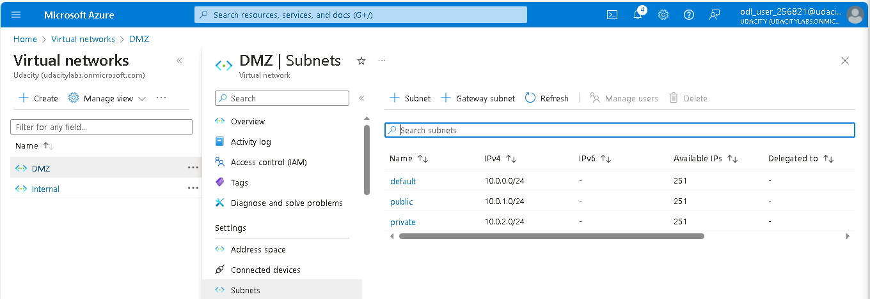
2.1.2 Screenshot
Create 2 subnets within your DMZ - subnets should be public and private.

Slide 9
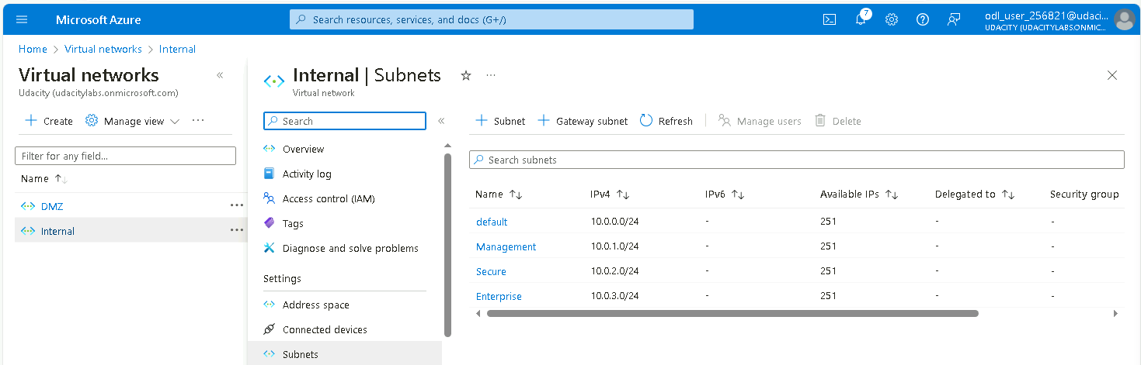
2.1.3 Screenshot
Create three subnets in your internal network and label them Management, Secure, and Enterprise.

Slide 10
2.2 Creating Virtual Machines
In this next section you will create Virtual Machines in your subnets. You will create 2 VMs in your DMZ and 3 VMs in your internal network. Please only use the Standard_B1s VM size and the Linux Ubuntu 18.04 image.
Insert screenshots on the following pages, showing completion of each of the specified tasks.

Slide 11
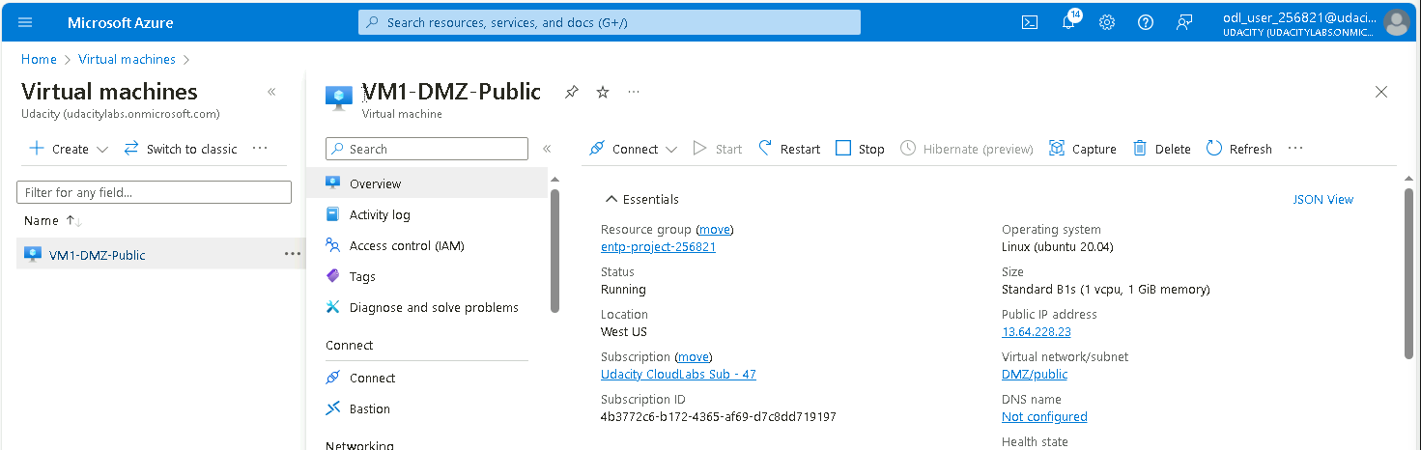
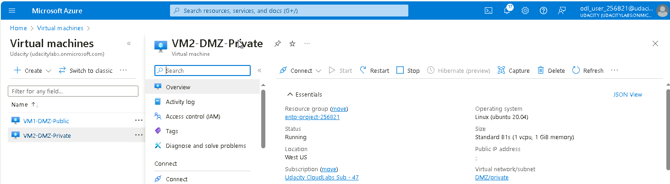
2.2.1 Screenshot
Create one VM in each of your public and private DMZ subnets. Please only use Standard_B1s for your VM size and select the Linux Ubuntu 18.04 image, otherwise you will encounter an error.

Slide 12
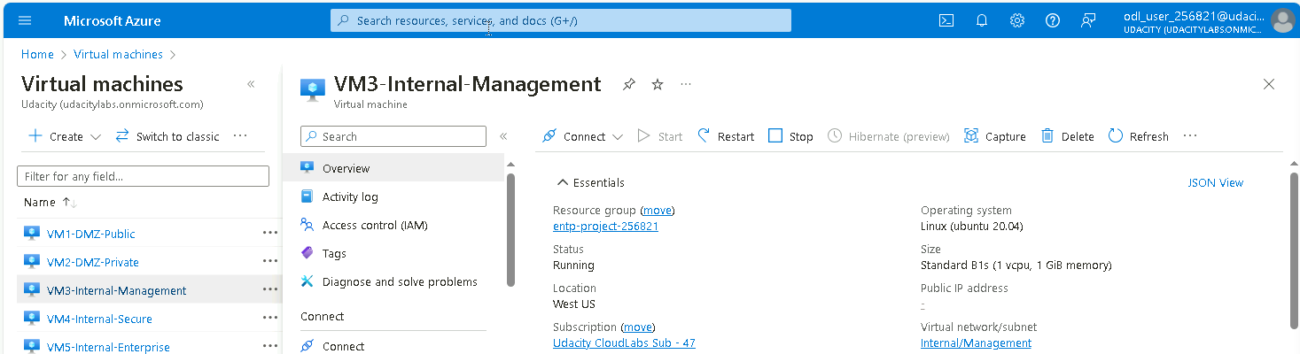
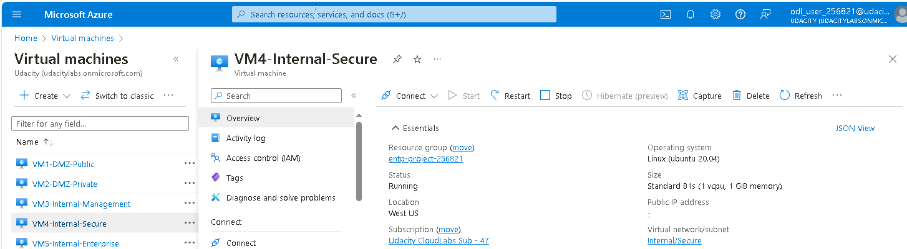
2.2.2 Screenshot
Create one VM in each of your Management, Secure, and Enterprise internal subnets. Please only use Standard_B1s for your VM size and select the Linux Ubuntu 18.04 image, otherwise you will encounter an error.

Slide 13
2.3 Secure Routing
In this next section you will configure secure routing within your Virtual Network and subnets. Follow secure best practices when creating network traffic rules.
Insert screenshots on the following pages, showing completion of each of the specified tasks.

Slide 14
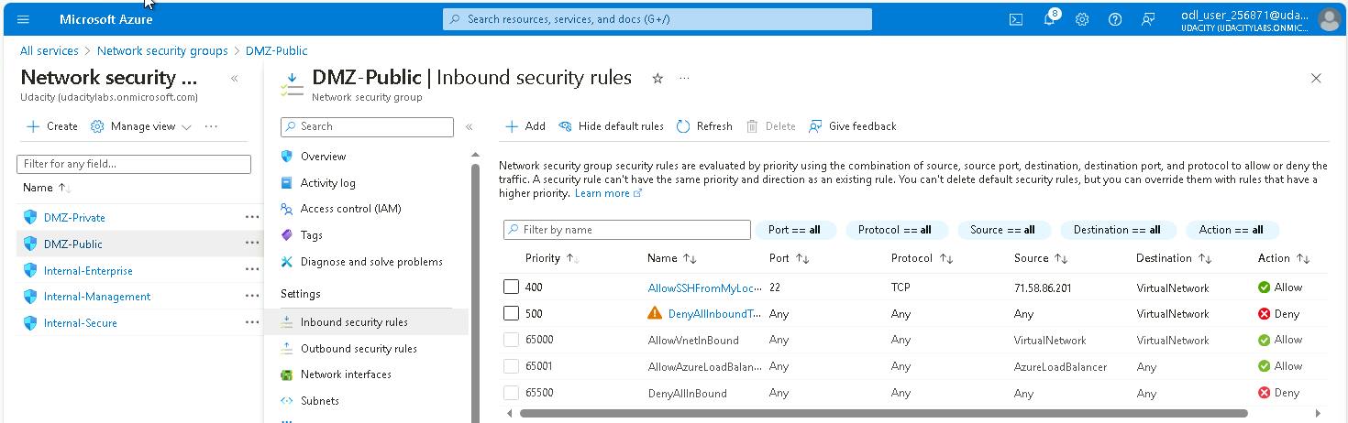
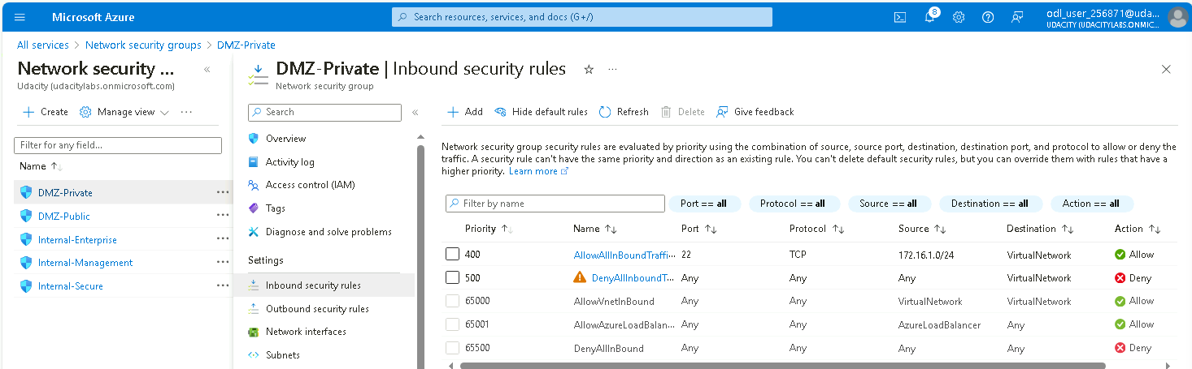
2.3.1 Screenshot
Traffic rules in your DMZ.
DMZ - Public
DMZ - Private

Slide 15
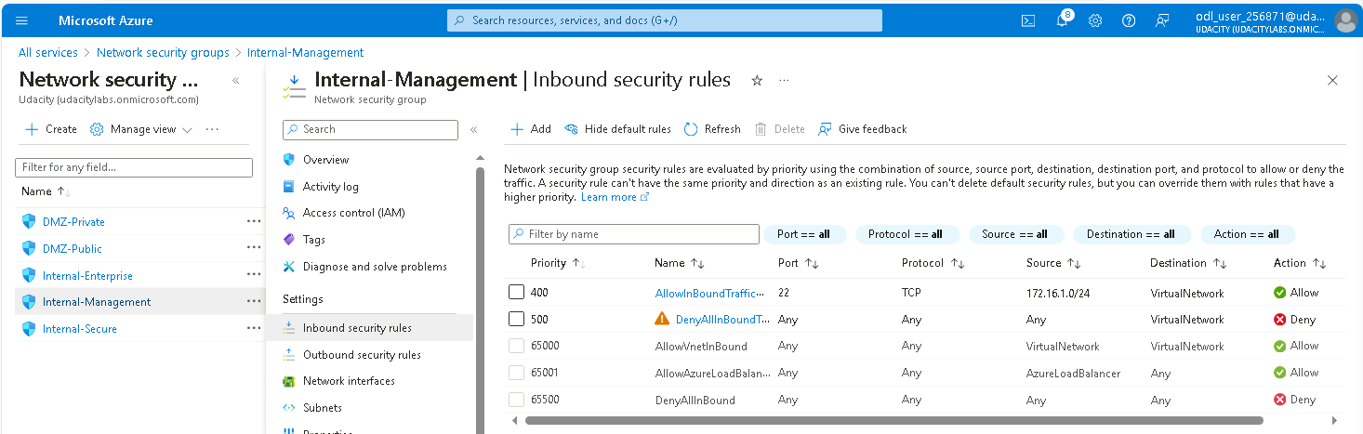
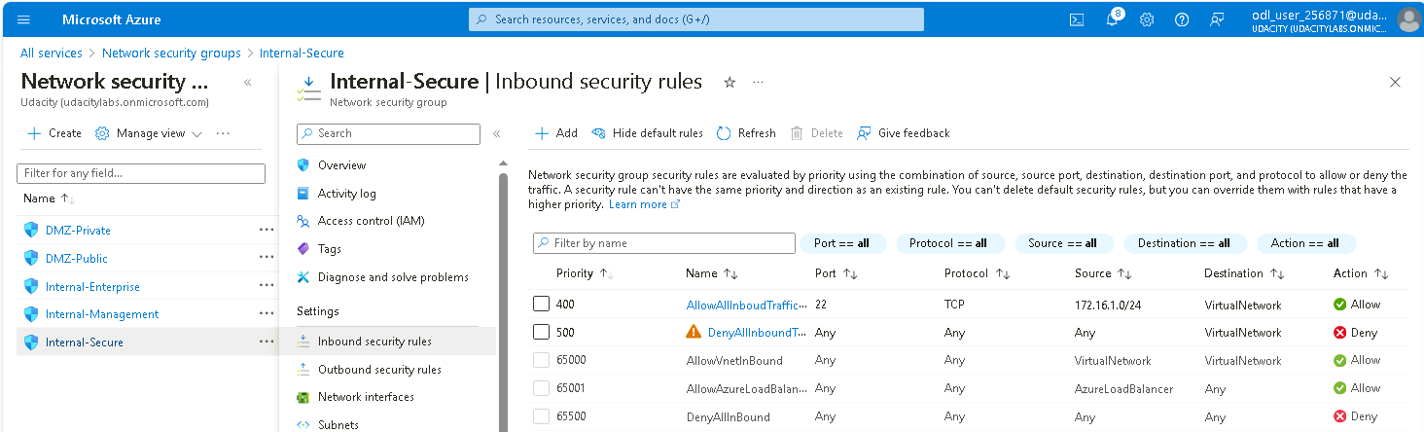

2.3.2 Screenshot
Traffic rules in your Internal network.
Internal - Management
Internal - Secure
Internal - Enterprise

Slide 16
2.4 VPN Access
In this next section you will create a VPN to secure access to your internal network. After creating your VPN, test your VPN connection and attempt connecting to one of your VMs in your internal network.
Insert screenshots on the following pages, showing completion of each of the specified tasks.

Slide 17
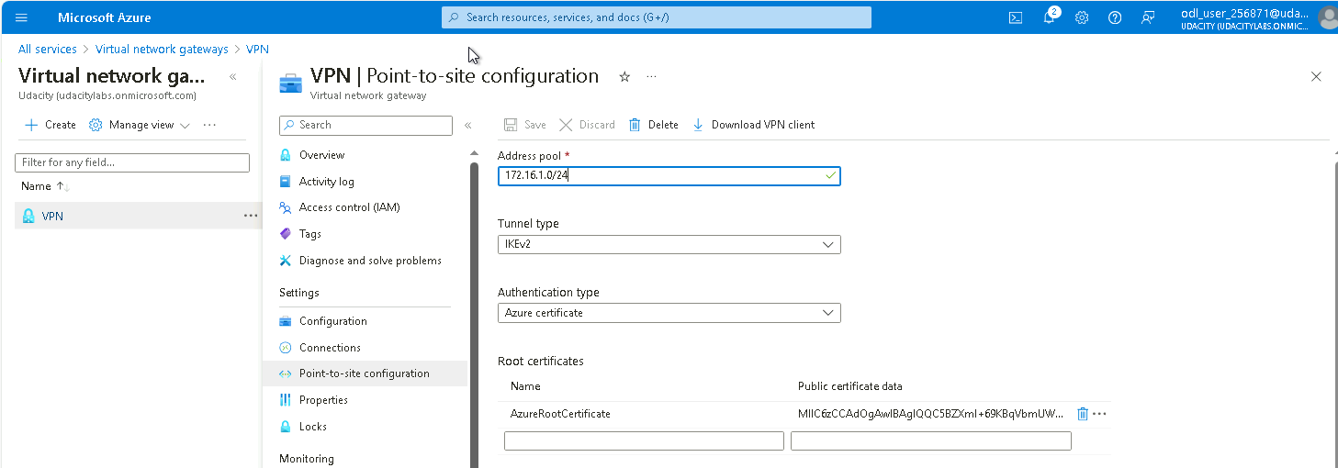
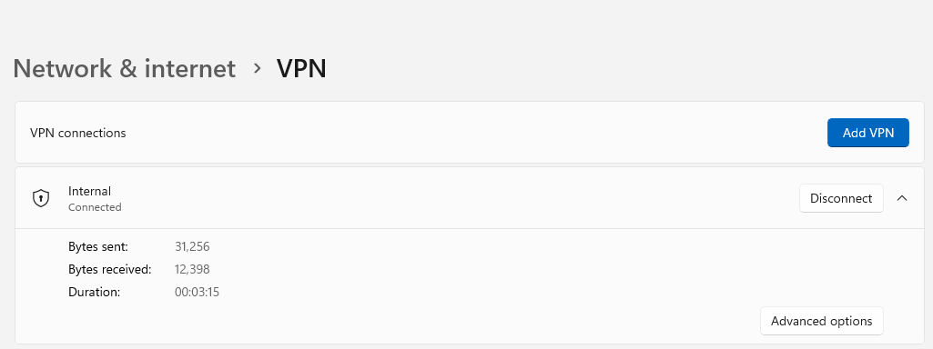
2.4.1 Screenshot
Create a VPN to connect to your internal network.

Slide 18
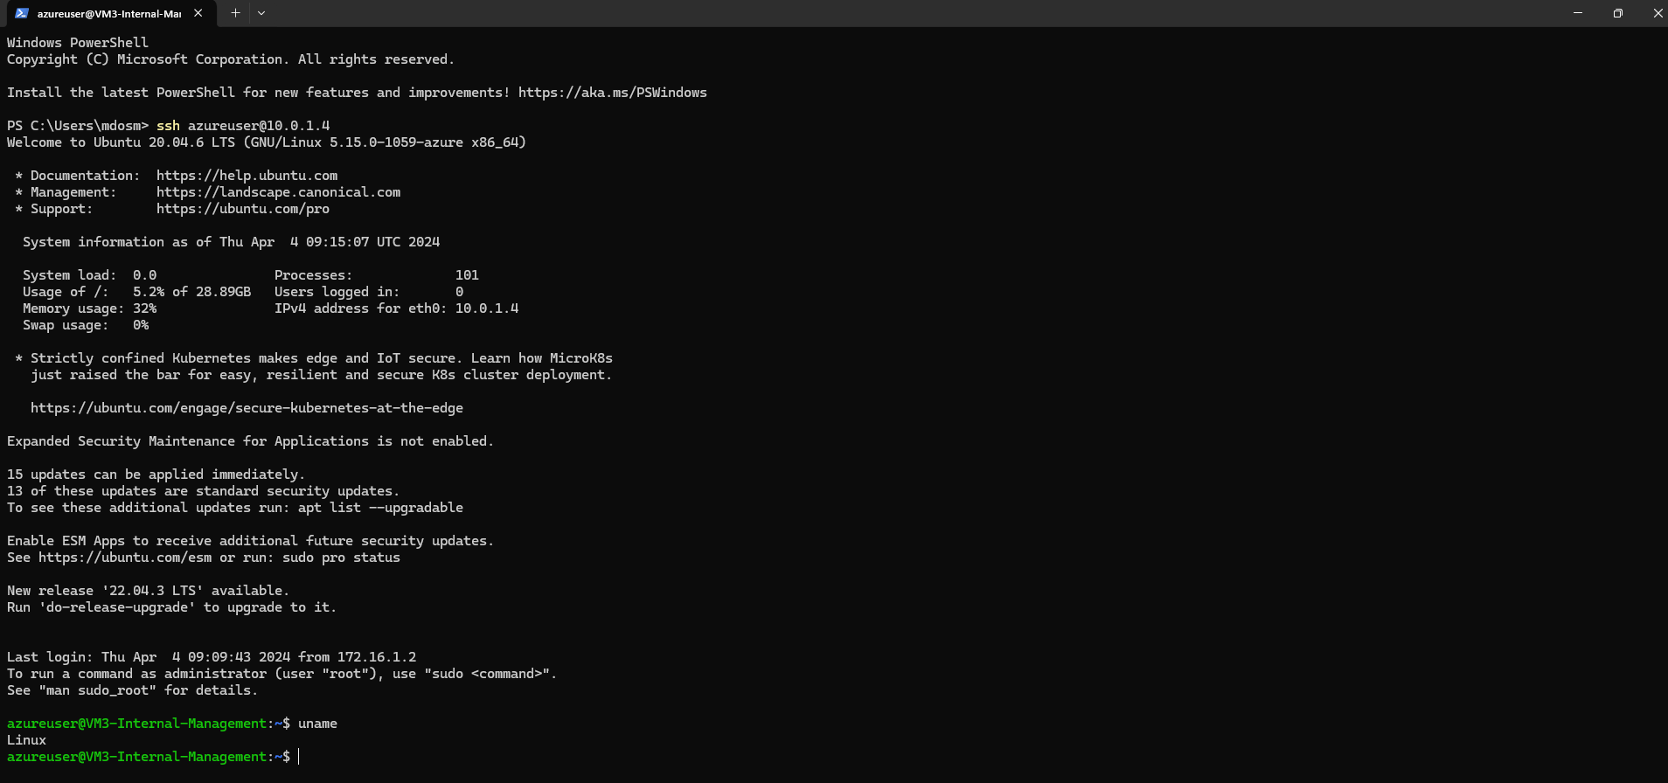
2.4.2 Screenshot
Test VPN connection by connecting to one of the VMs in your internal network.

Slide 19
Section 3
Continuous Monitoring with a SIEM

Slide 20
Section 3: Build the SIEM
Now that you've built a secure network architecture and a Zero Trust model, you're ready to wrap up your contract and finish the last piece of work. Your last task is to set up a solution to monitor the enterprise network and alert you about potential attacks.
For this section, you will continue working in the Project Workspace in the classroom, then provide screenshots of your work here in this document.
Insert screenshots on the following pages, showing completion of each of the specified tasks.

Slide 21
3.1.1 Screenshot
Create a VM in your private DMZ. On that VM, go through the process to create an ELK Server. For your Elk Server use the VM size DS1_v2 and Linux Ubuntu 18.04 image.

Slide 22
3.1.2 Screenshot
Set up routing to only allow traffic inbound to the server from both your virtual networks, and make sure Kibana is only accessible when you're on the network.

Slide 23
3.2 Ingest Logs
In this next section, you will start setting up ingest sources for your ELK server.
Insert screenshots on the following pages, showing completion of each of the specified tasks.

Slide 24
3.2.1 Screenshot
Install Filebeat on your web servers and show the Filebeat service as active.

Slide 25
3.2.2 Screenshot
Configure Filebeat to route web server logs to Elasticsearch.

Slide 26
3.2.3 Screenshot
Simulate web traffic to your web servers using https://www.babylontraffic.com.

Slide 27
3.2.4 Screenshot
Web server logs appear in Kibana.

Slide 28
3.3 Build Alerts
In this next section, you will create alerts on the simulated web traffic you see. Build alerts to alert you of possible DoS, brute force, and probing attacks.
Insert screenshots on the following pages, showing completion of each of the specified tasks.

Slide 29
3.3.1 Screenshot
Create an alert for DoS attack.

Slide 30
3.3.2 Screenshot
Create an alert for Brute Force attack.

Slide 31
3.3.3 Screenshot
Create an alert for a scanning attack. During the scan, an attacker is looking to identify what ports are open.

Slide 32
3.4 Incident Response Playbook
Write a playbook below, detailing what the set of steps would be in response to each of the alerts you created in the last section 4.3. Add more pages if you need.

Slide 33
Section 4
Designing a
Zero Trust Model

Slide 34
Section 4: Zero Trust Model
XYZ is elated with the work you've done so far! But they've been hearing about this new buzzword "Zero Trust" and are curious as to what it is and what the architecture would look like in a Zero Trust model. So your next task below is to design a Zero Trust model, then explain the differences between your network architecture and your Zero Trust model.
Design a Zero Trust model of your network architecture using https://app.diagrams.net/.
Make sure to incorporate the following into your design:
- Identity
- Devices
- Apps
- Network
- Data
- Infrastructure
- Trusted and Untrusted Devices
- Controls

Slide 35
4.1 Zero Trust Model
Paste your Zero Trust model diagram here:
Remove this slide

Slide 36
4.2 Modern Architecture vs. Zero Trust
Write a detailed comparative analysis of the differences between your Zero Trust model and your secure network architecture design.

